Slide 1
Spring Framework Basics
Notes:
https://www.baeldung.com/inversion-control-and-dependency-injection-in-spring

Slide 2
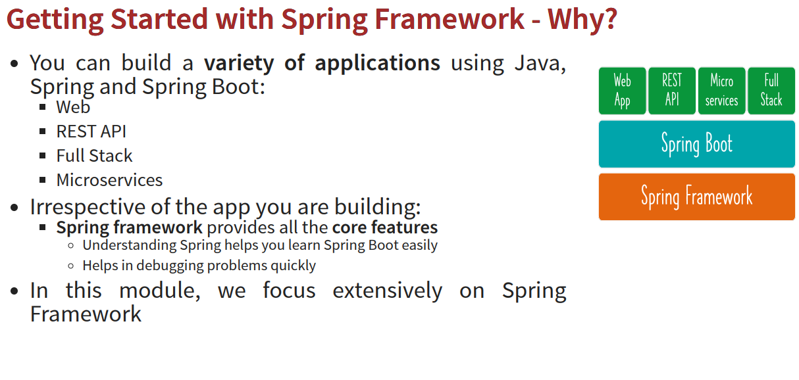

Slide 3

Getting Started with Spring Framework - Goals
Goal – Understand core features of Spring Framework
Approach - Build a Loose Coupled Hello World Gaming App with Modern Spring Approach
Get Hands-on with Spring and understand:
Why Spring?
Terminology
Tight Coupling and Loose Coupling
IOC Container Application Context Component Scan Dependency Injection Spring Beans
Auto Wiring

Slide 4
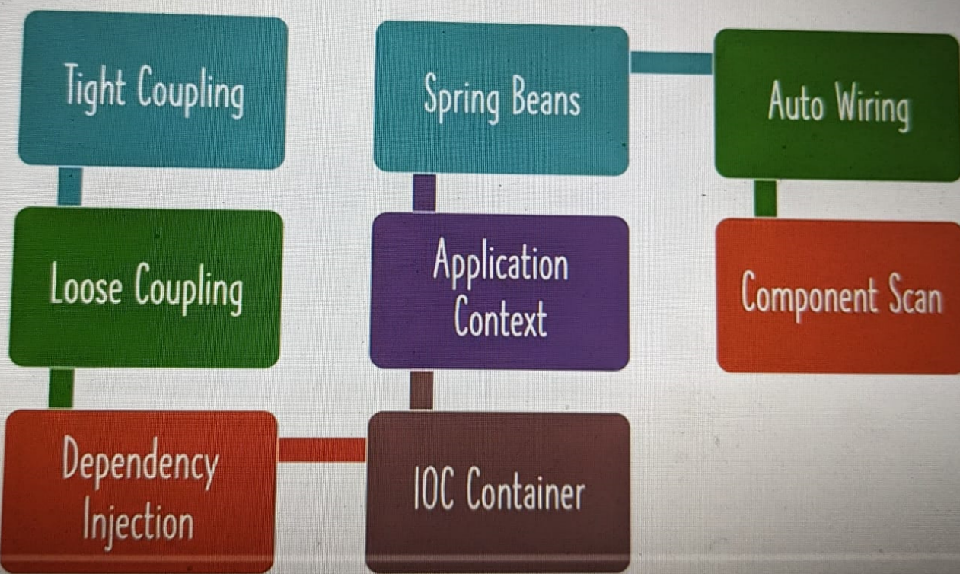

Slide 5

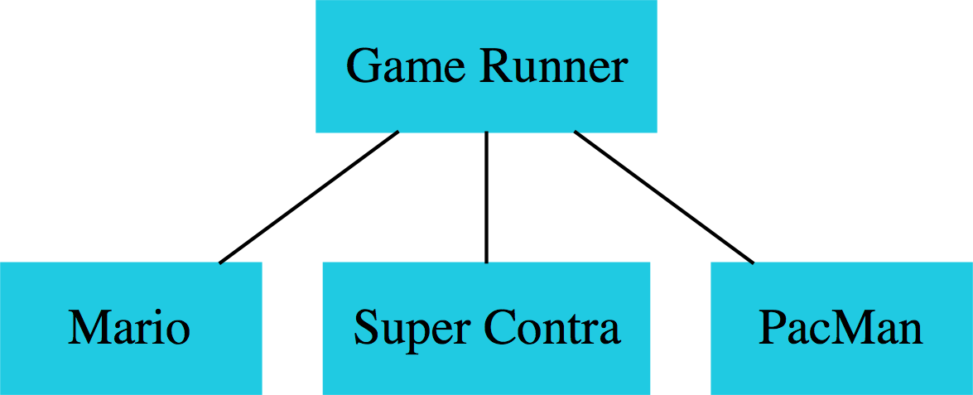
Loose Coupling with Spring Framework
Design Game Runner to run games:
Mario, Super Contra, PacMan etc
Iteration 1: Tightly Coupled
GameRunner class
Game classes: Mario, Super Contra, PacMan etc
Iteration 2: Loose Coupling - Interfaces
GameRunner class
GamingConsole interface
Game classes: Mario, Super Contra, PacMan etc
Iteration 3: Loose Coupling – Spring Level 1
Spring Beans
Spring framework will manage all our objects!
GameRunner class
GamingConsole interface
Game classes: Mario, Super Contra, PacMan etc
Iteration 4: Loose Coupling – Spring Level 2
Spring Annotations
Spring Framework will create, manage and autowire objects.

Slide 6
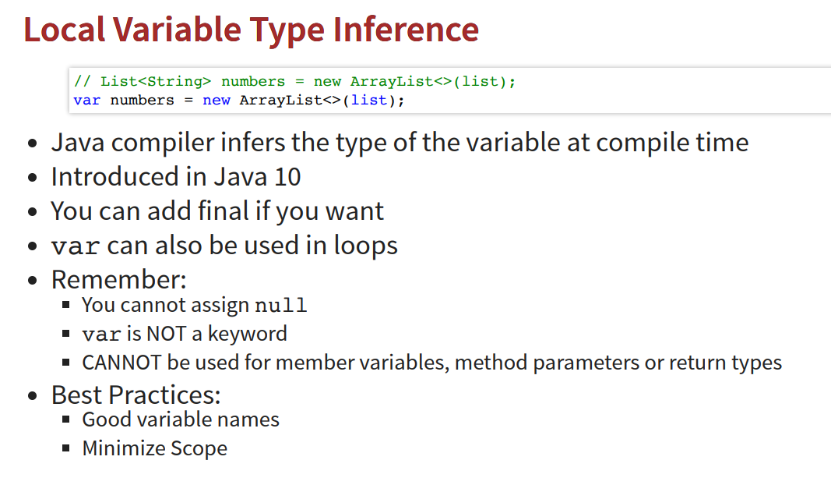

Slide 7
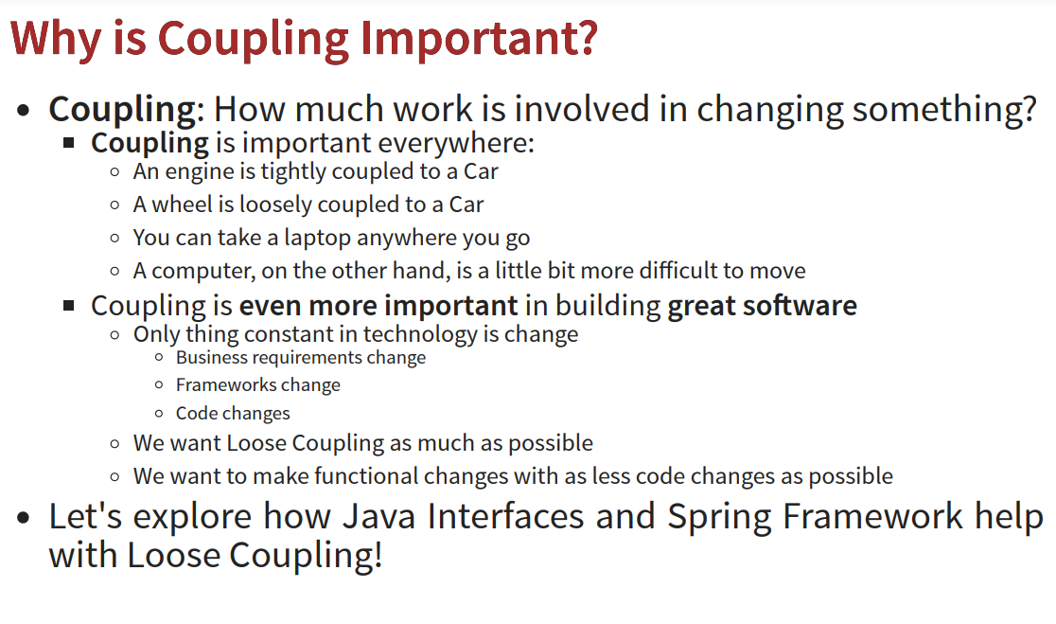

Slide 8
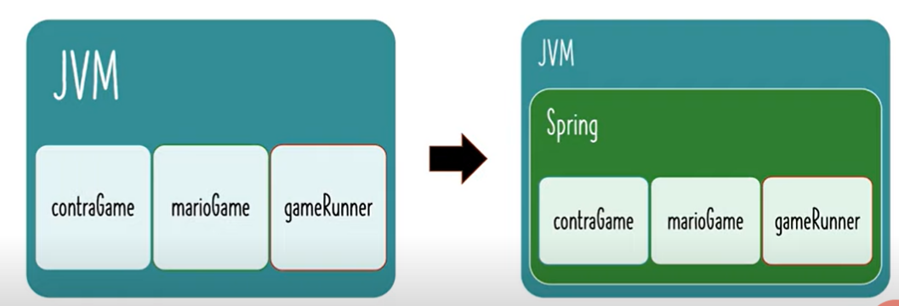

Slide 9
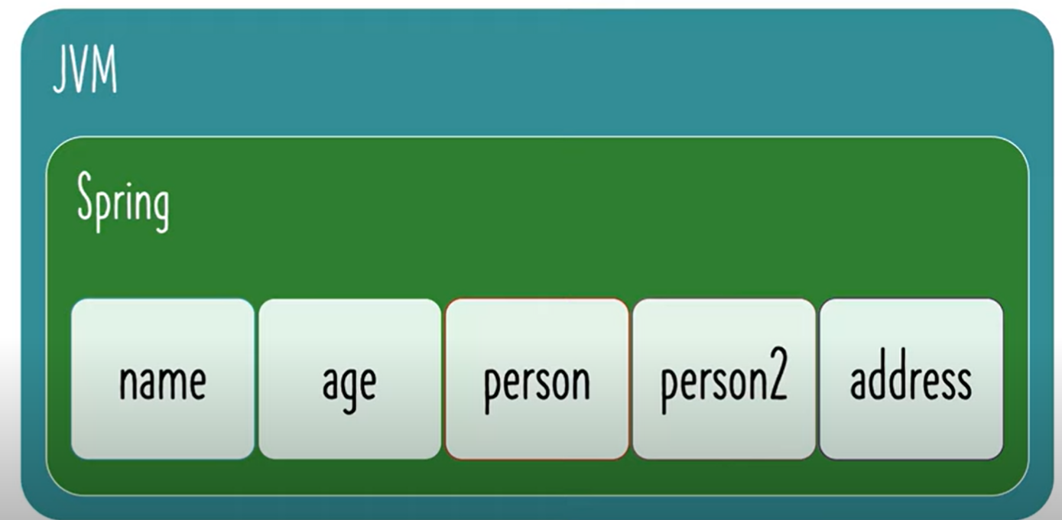

Slide 10
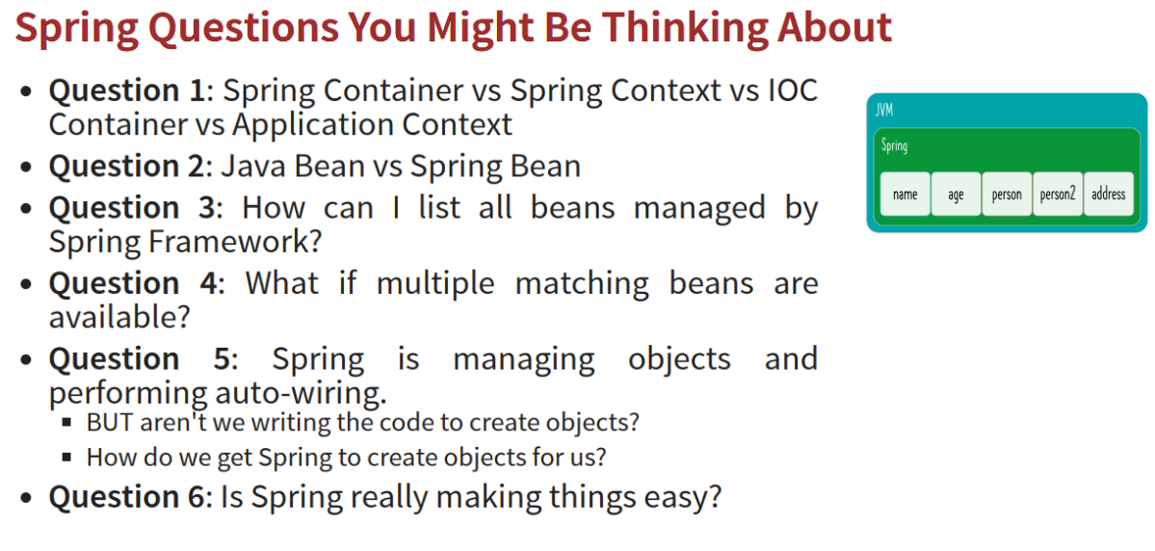

Slide 11
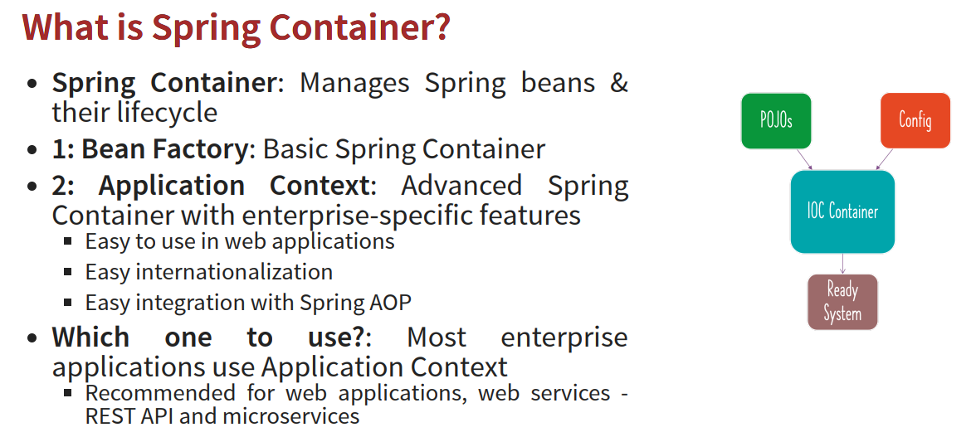

Slide 12
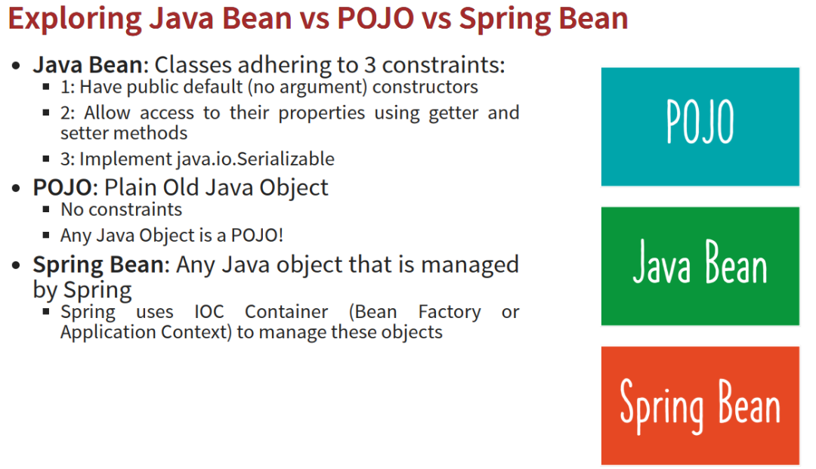

Slide 13
2. What Is Inversion of Control?
Inversion of Control is a principle in software engineering which transfers the control of objects or portions of a program to a container or framework.
We most often use it in the context of object-oriented programming.
In contrast with traditional programming, in which our custom code makes calls to a library, IoC enables a framework to take control of the flow of a program and make calls to our custom code. To enable this, frameworks use abstractions with additional behavior built in. If we want to add our own behavior, we need to extend the classes of the framework or plugin our own classes.
The advantages of this architecture are:
decoupling the execution of a task from its implementation
making it easier to switch between different implementations
greater modularity of a program
greater ease in testing a program by isolating a component or mocking its dependencies, and allowing components to communicate through contracts
We can achieve Inversion of Control through various mechanisms such as: Strategy design pattern, Service Locator pattern, Factory pattern, and Dependency Injection (DI).

Slide 14
Spring IoC (Inversion of Control)
Spring IoC (Inversion of Control) Container is the core of Spring Framework.
It creates the objects, configures and assembles their dependencies, manages their entire life cycle.
The Container uses Dependency Injection(DI) to manage the components that make up the application.
It gets the information about the objects from a configuration file(XML) or Java Code or Java Annotations and Java POJO class. These objects managed by container are called Beans.
Since the Controlling of Java objects and their lifecycle is not done by the developers, hence the name Inversion Of Control. The followings are some of the main features of Spring IoC,
Creating Object for us,
Managing our objects,
Helping our application to be configurable,
Managing dependencies

Slide 15
Dependency Injection in Spring can be done through constructors, setters or fields.

Slide 16
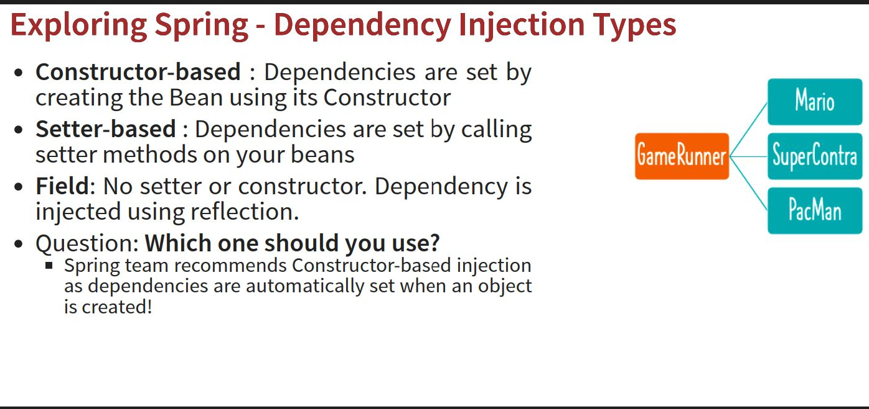

Slide 17
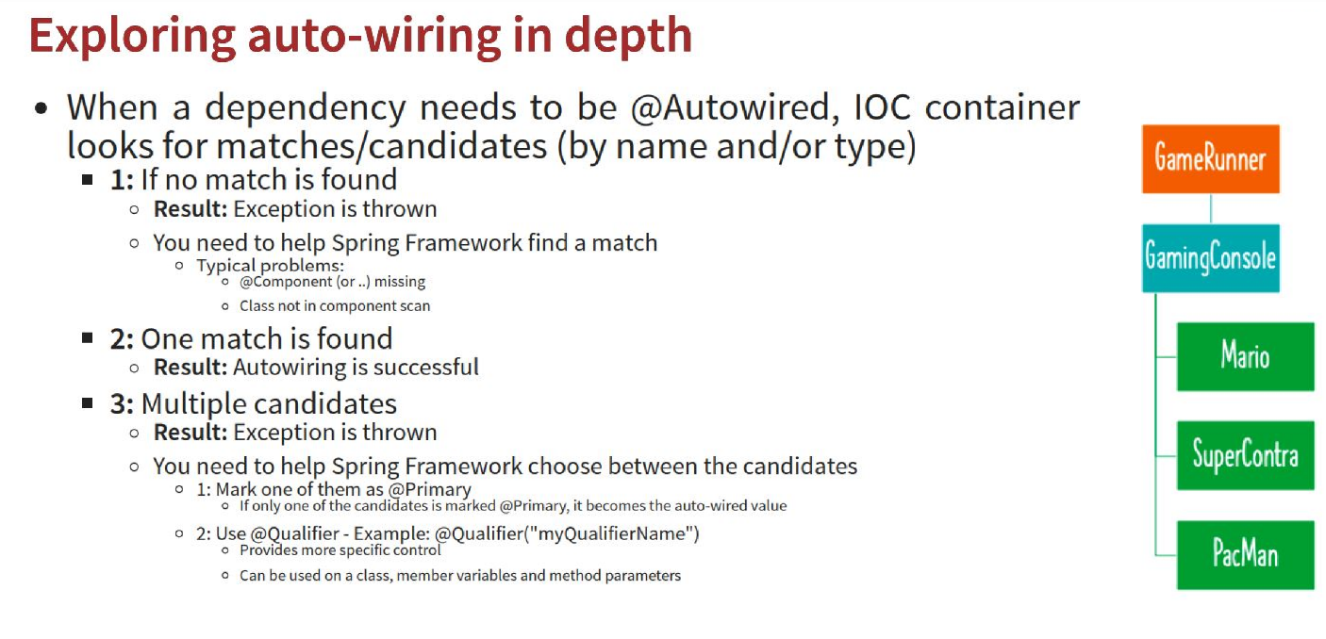

Slide 18
Regarding using @Autowired with constructor injection:-
Starting with Spring 4.3, if a class, which is configured as a Spring bean, has only one constructor, the @Autowired annotation can be omitted and Spring will use that constructor and inject all necessary dependencies.
If there are multiple constructors u need a constructor with @Autowired annotation.
Regarding default constructor:-
Regarding the default constructor: You either need the default constructor, a constructor with the @Autowired annotation when you have multiple constructors, or only one constructor in your class with or without the @Autowired annotation.

Slide 19
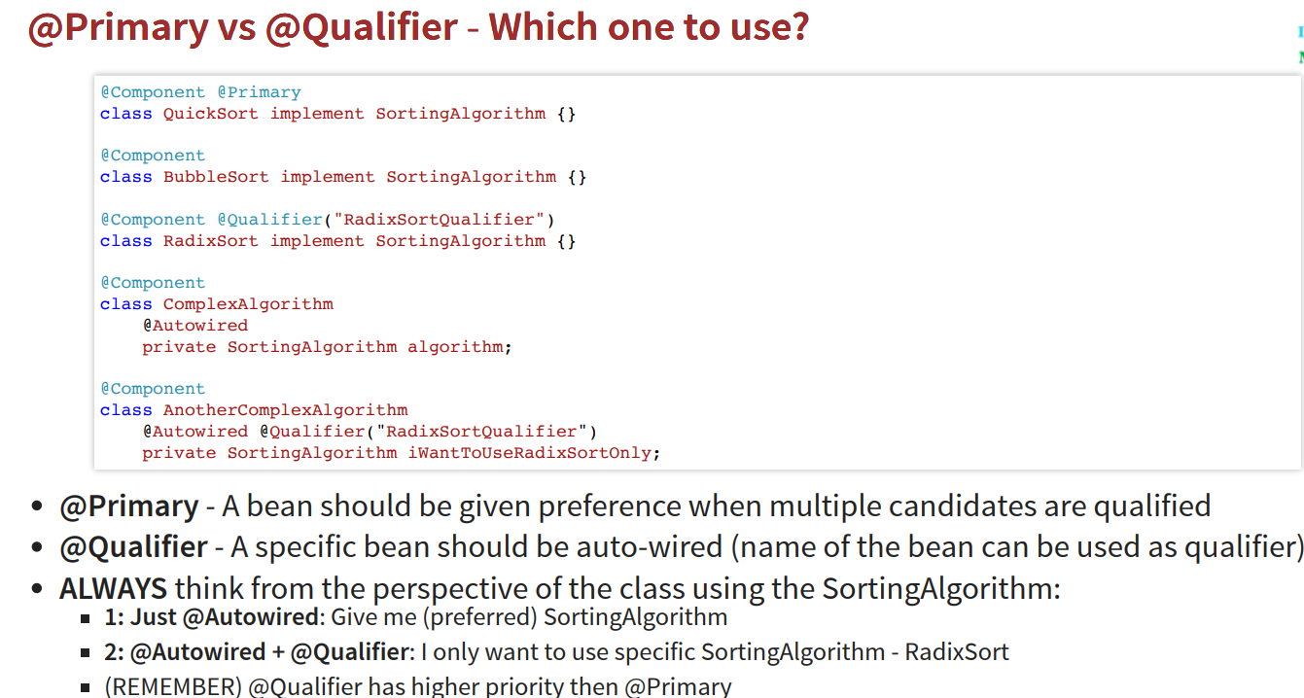

Slide 20
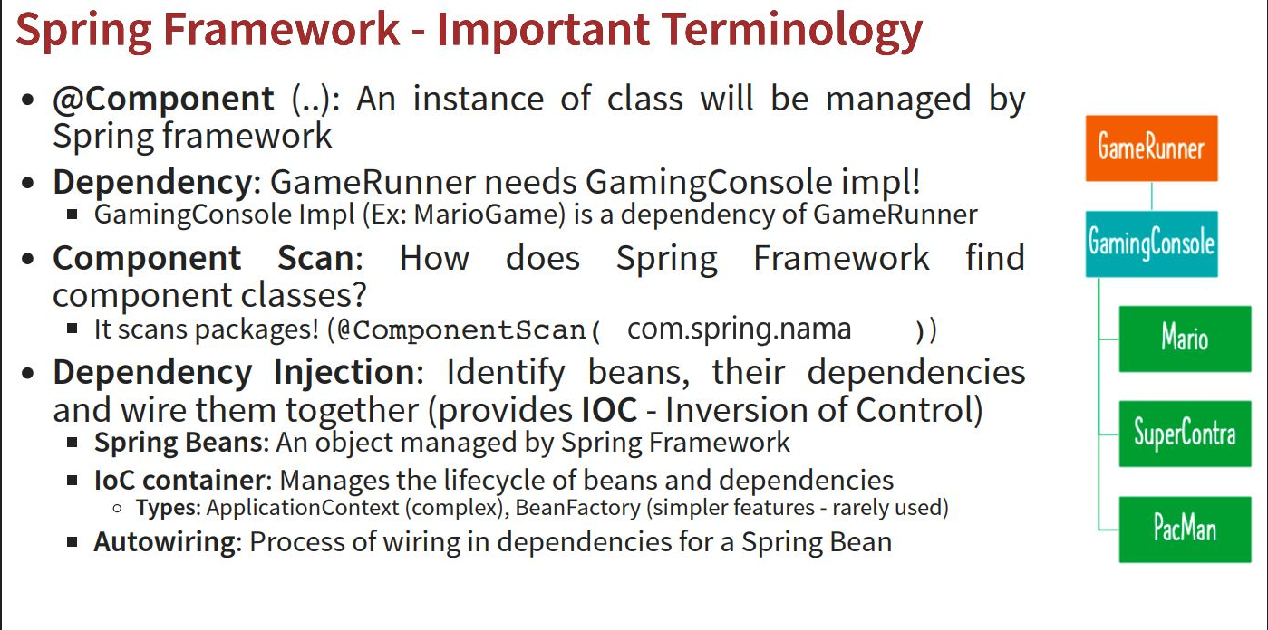

Slide 21
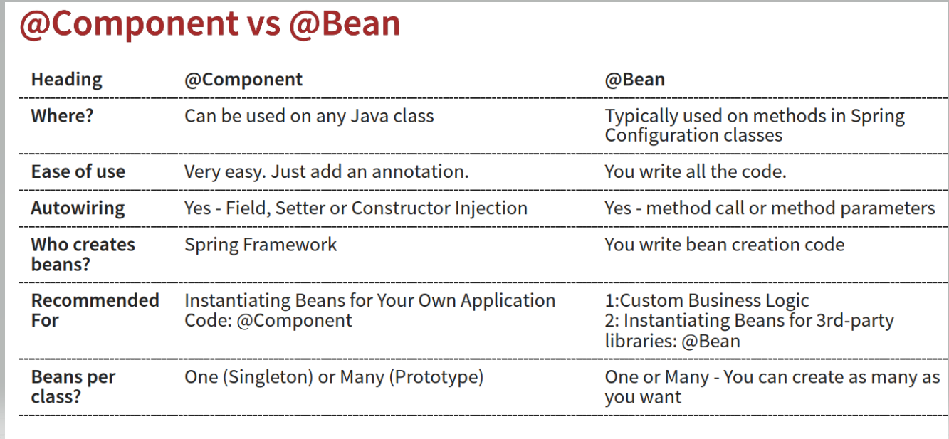

Slide 22
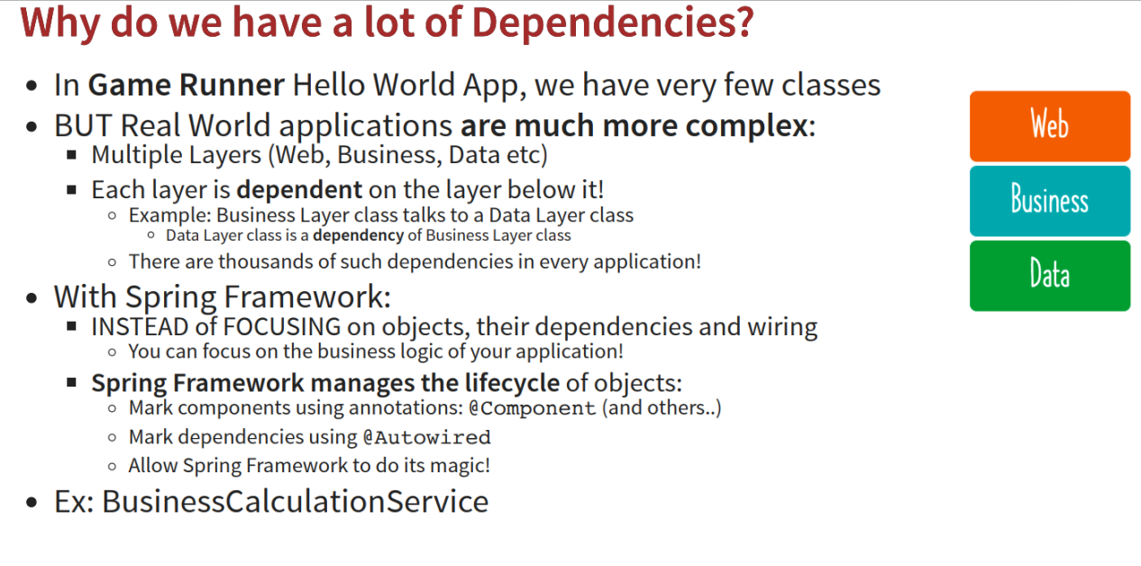

Slide 23
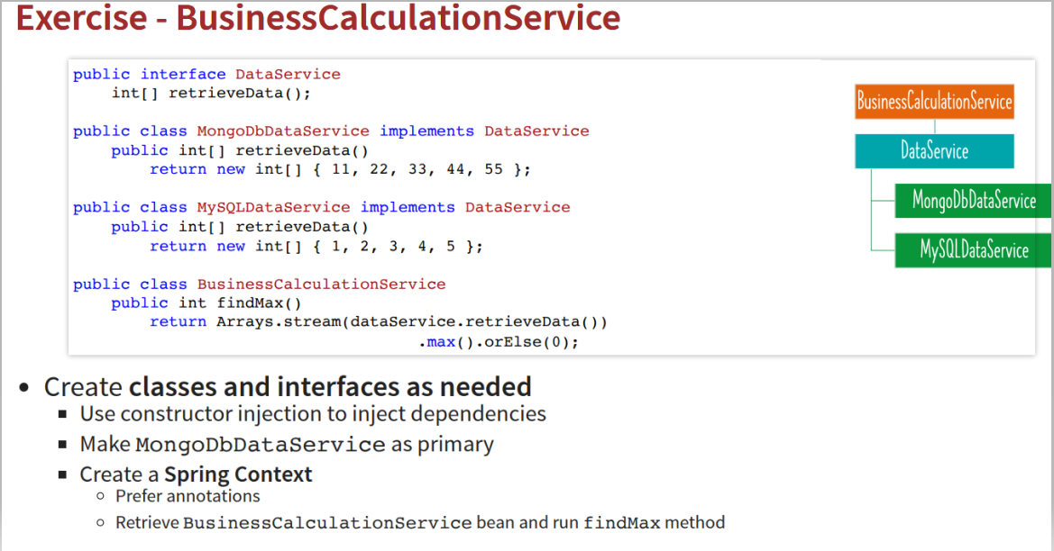

Slide 24
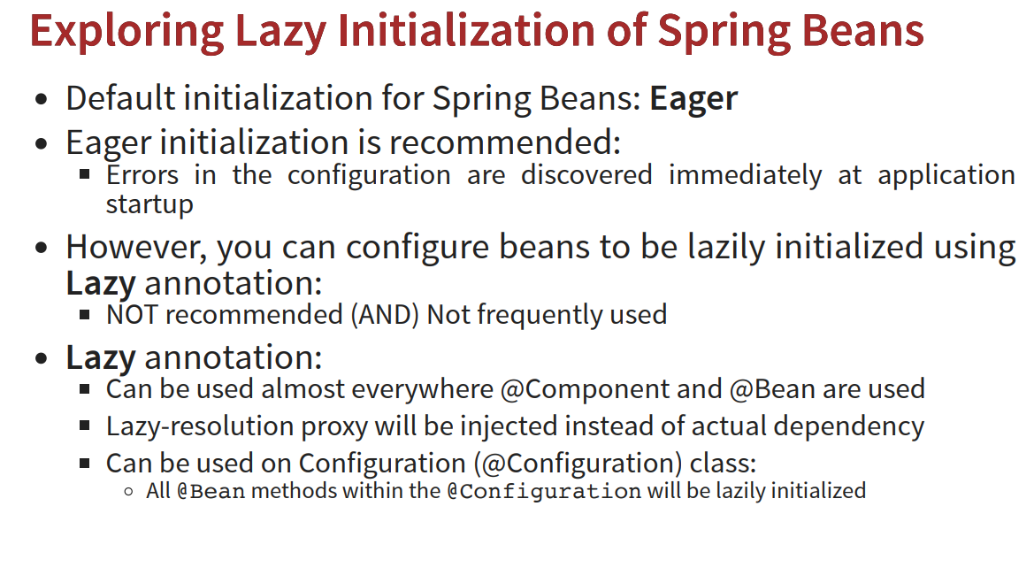

Slide 25
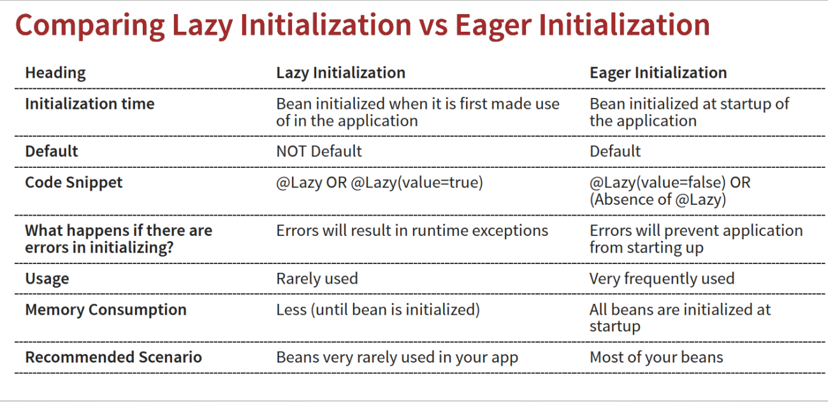

Slide 26
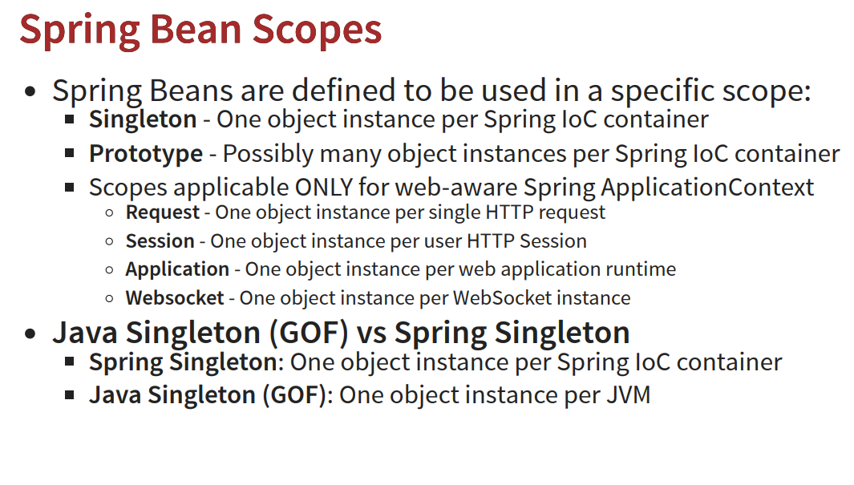
Notes:
https://www.codeburps.com/post/singleton-pattern

Slide 27
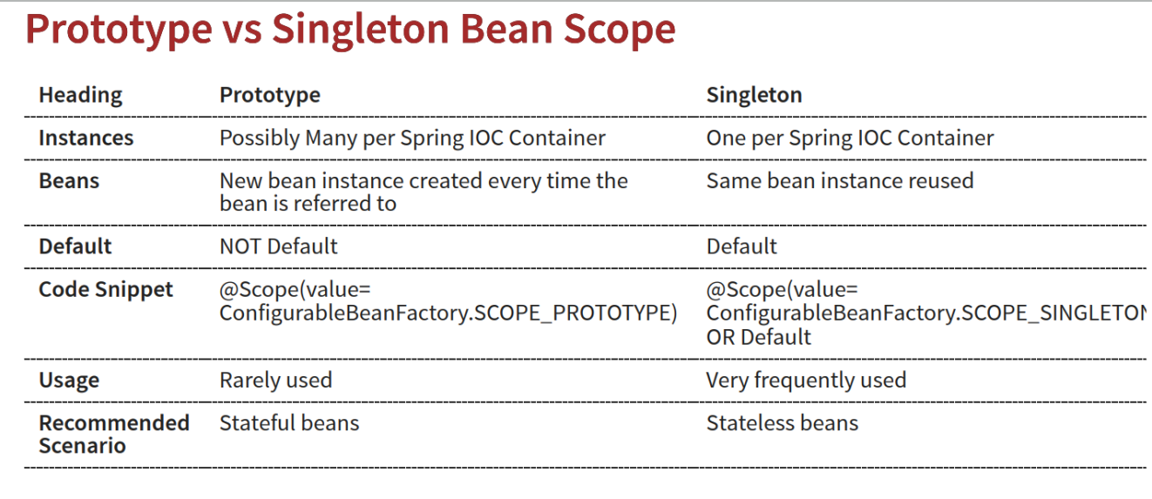

Slide 28
Lifecycle of a Bean
A Spring bean needs to be instantiated when the container starts, based on Java or XML bean definition. The framework may also be required to perform some pre and post-initialization steps to get the bean into a usable state.
After that, when the bean is no longer required, it will be removed from the IoC container. Like the initialization phase, the Spring framework may need to perform pre-and post-destruction steps to free the other system resources.
The Spring bean factory is responsible for managing the life cycle callbacks of the beans which are created in the spring containers.

Slide 29
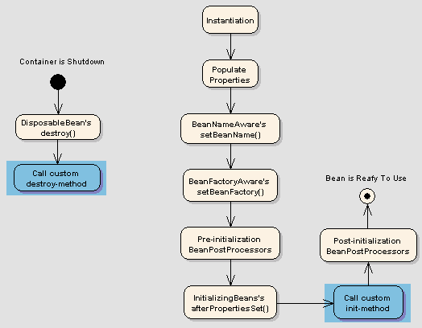
Bean Lifecycle Callback Methods

Slide 30
Customize the Bean Life Cycle
How to Customize the Bean Life Cycle?
Spring framework provides the following four ways for controlling life cycle events of a bean:
InitializingBean and DisposableBean callback interfaces
*Aware interfaces for specific behavior
Custom init() and destroy() methods in bean configuration file
@PostConstruct and @PreDestroy annotations
Notes:
https://howtodoinjava.com/spring-core/spring-bean-life-cycle/

Slide 31
Bean Post Processor
A bean post processor allows for custom modification of new bean instances created by spring bean factory.
If you want to implement some custom logic after the Spring container finishes instantiating, configuring, and initializing a bean, we can plug in one or more BeanPostProcessor implementations.
In case of multiple BeanPostProcessor instances, we can control the order by setting the order property or implement Ordered interface.
Notes:
https://howtodoinjava.com/spring-core/spring-bean-post-processors/

Slide 32
Bean Post Processor
BeanPostProcessor interface consists of exactly two callback methods:-
postProcessBeforeInitialization()
postProcessAfterInitialization().
For each bean instance that is created by the container, the post-processor gets a callback from the container both time – before container initialization methods are called as well as after any bean initialization callbacks.
Usage:
It provides hooks for customizing beans or to modify their configuration during their lifecycle within the application.
It allows for direct modification of the beans themselves. For e.g.- It may be used to wrap a bean with a proxy, like some Spring AOP infrastructure classes (e.g. AbstractAdvisingBeanPostProcessor) are implemented as bean post-processors in order to provide proxy-wrapping logic.
Notes:
https://howtodoinjava.com/spring-core/spring-bean-life-cycle/

Slide 33
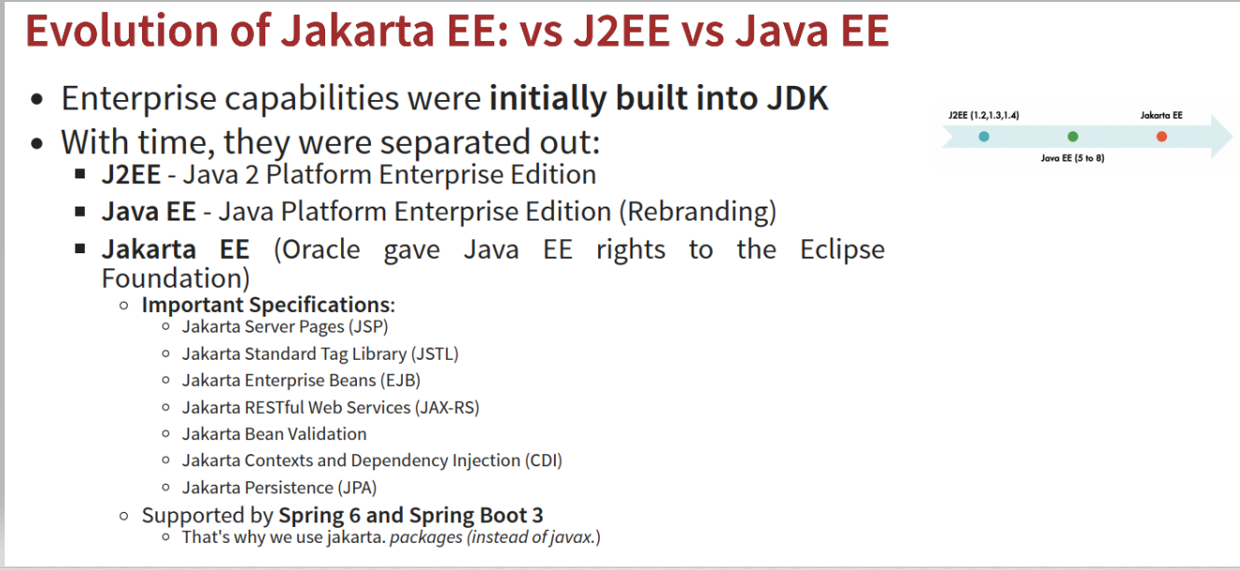

Slide 34
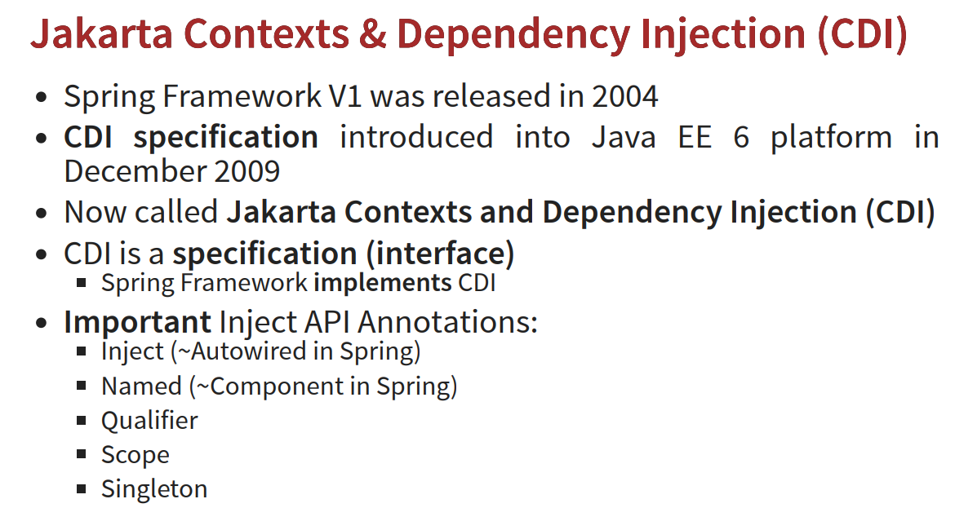

Slide 35
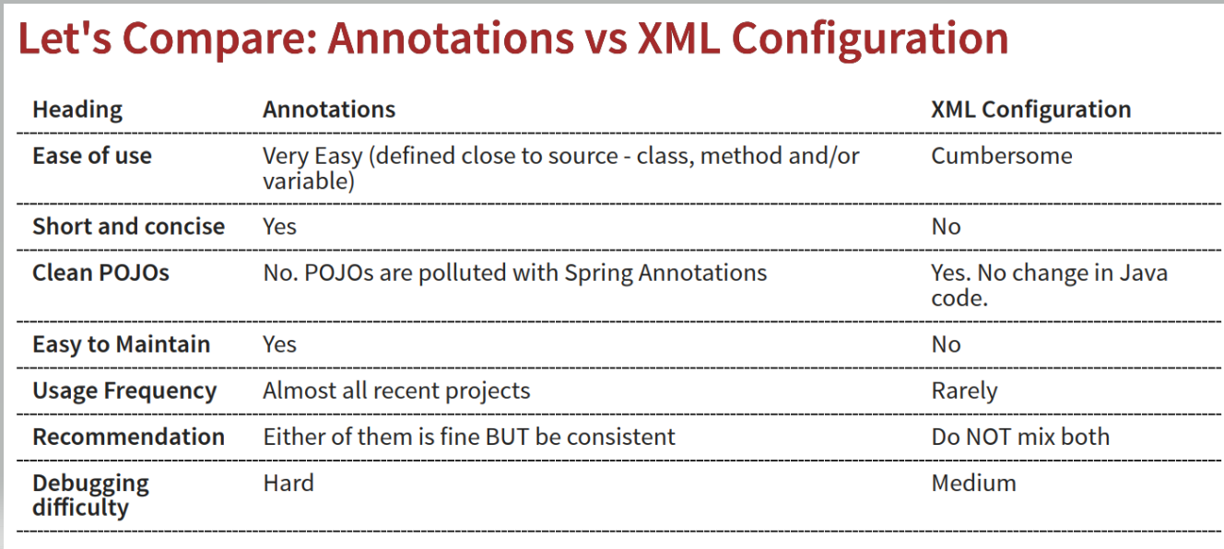

Slide 36
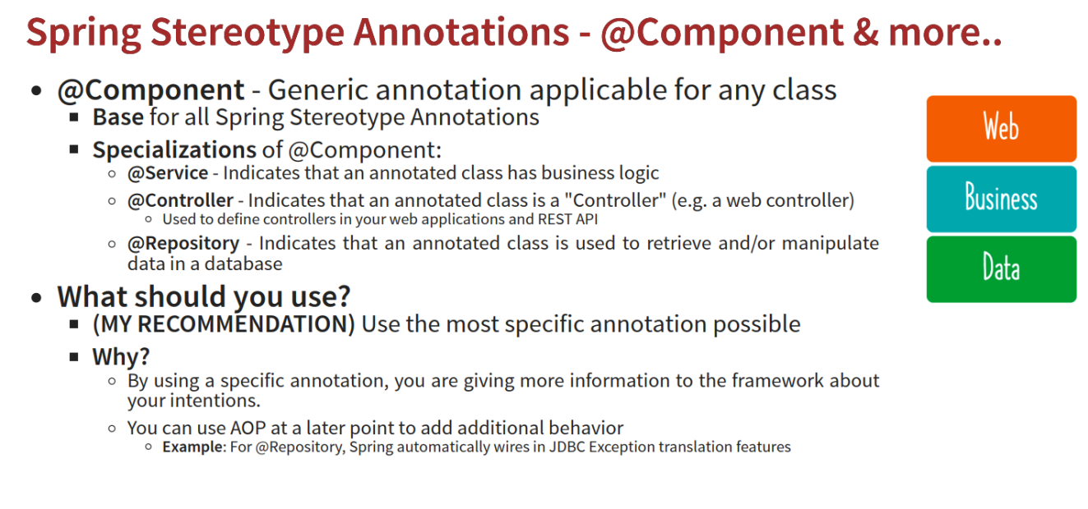

Slide 37
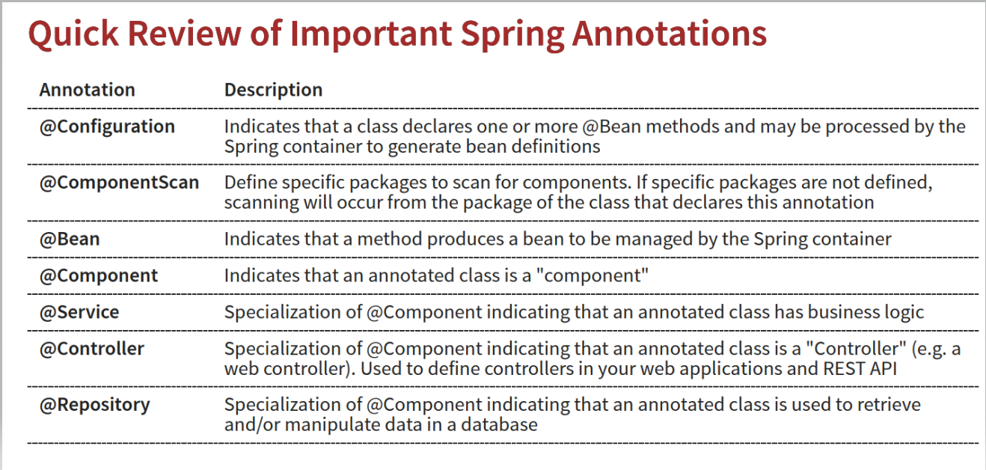

Slide 38
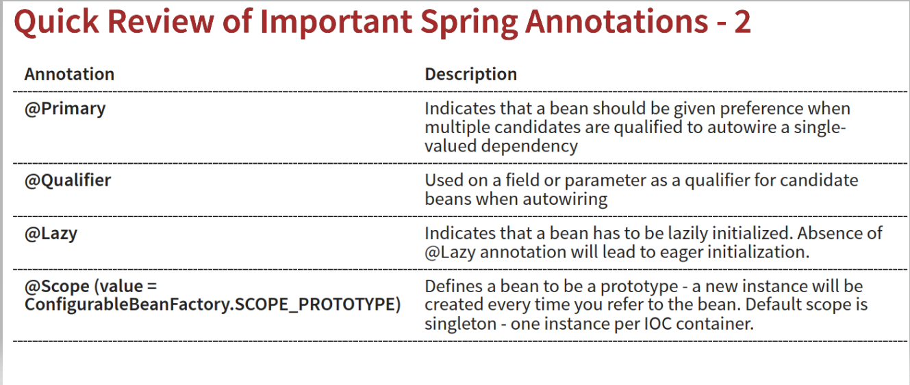

Slide 39
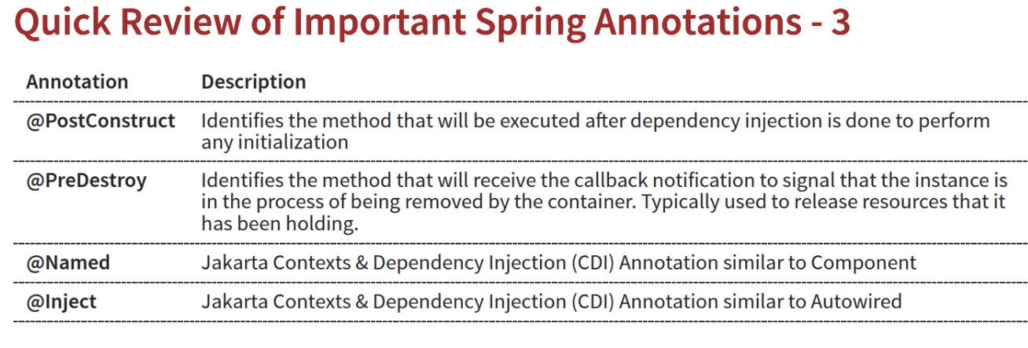

Slide 40
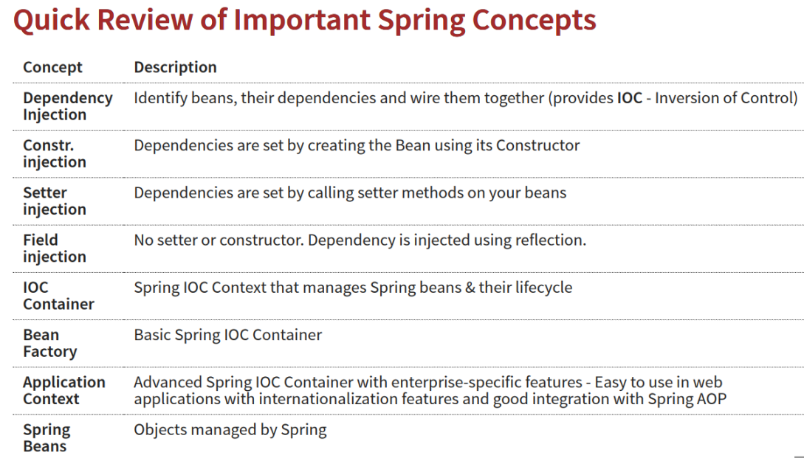

Slide 41
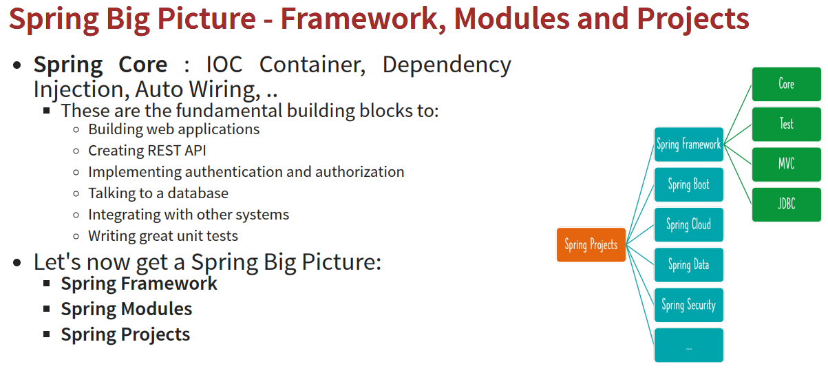

Slide 42
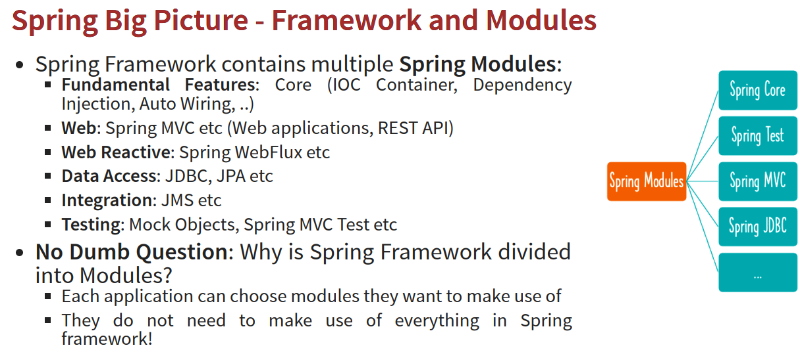

Slide 43
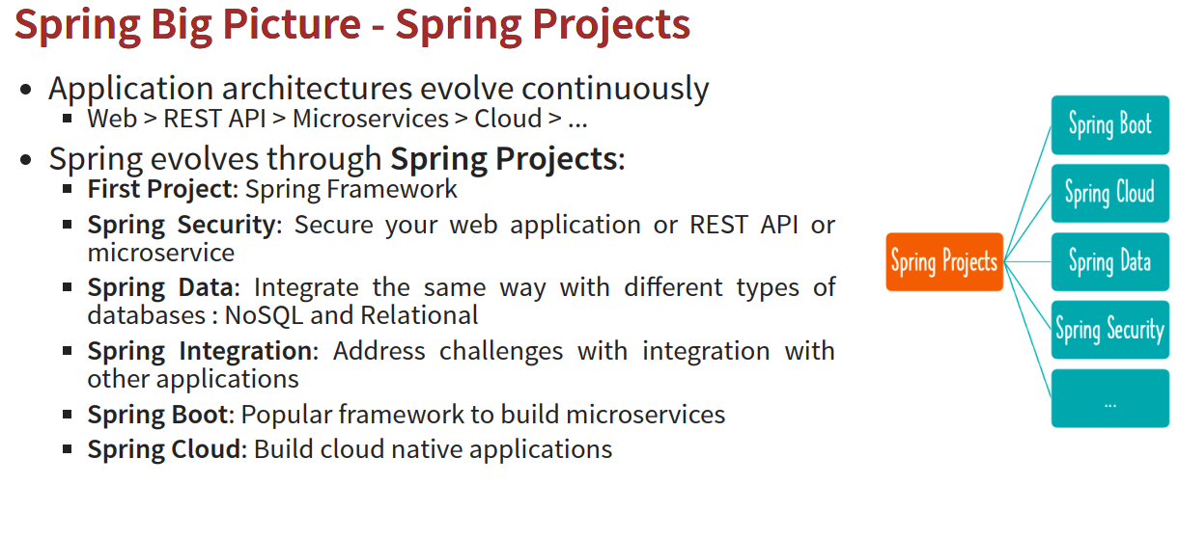

Slide 44
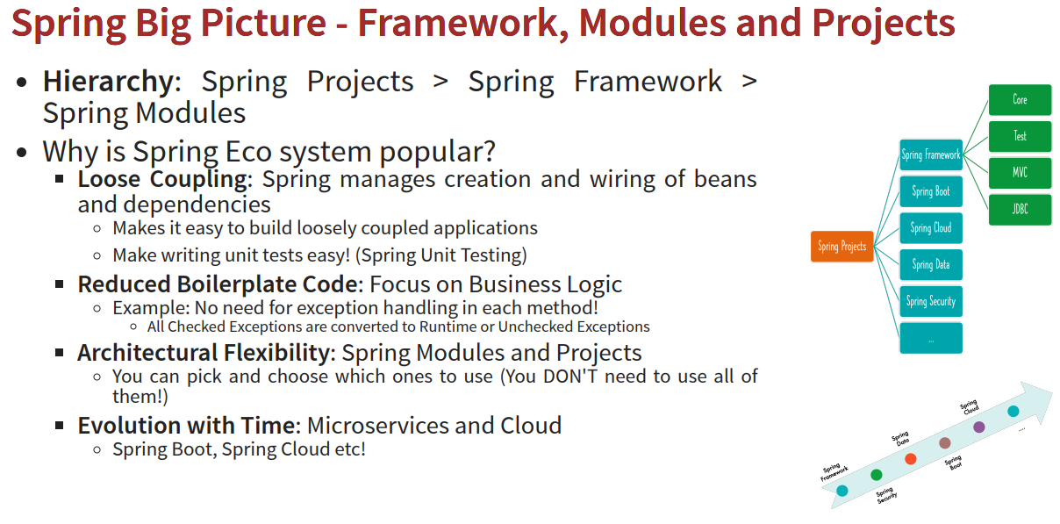

Slide 45
Thankyou for learning basics of Spring Framework!

